Slide 1
Importance of RTP in Tanzania
Presented by Innocent Ephraim: RPA

Slide 2
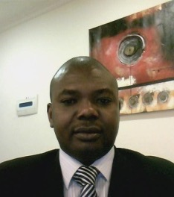
Isack Nchunda
Isack Nchunda is the CEO at Airtel Money Tanzania Ltd, Prior to that he was Director for Airtel Money and Marketing in Tanzania, He headed Zain Cash operations in Iraq and previously headed M-PESA Product development and Marketing dept at Vodacom Tanzania. He is a holder of MBA in Finance and Bachelor of Commerce in Accounting from University of Dar es salaam, Tanzania.

Slide 3
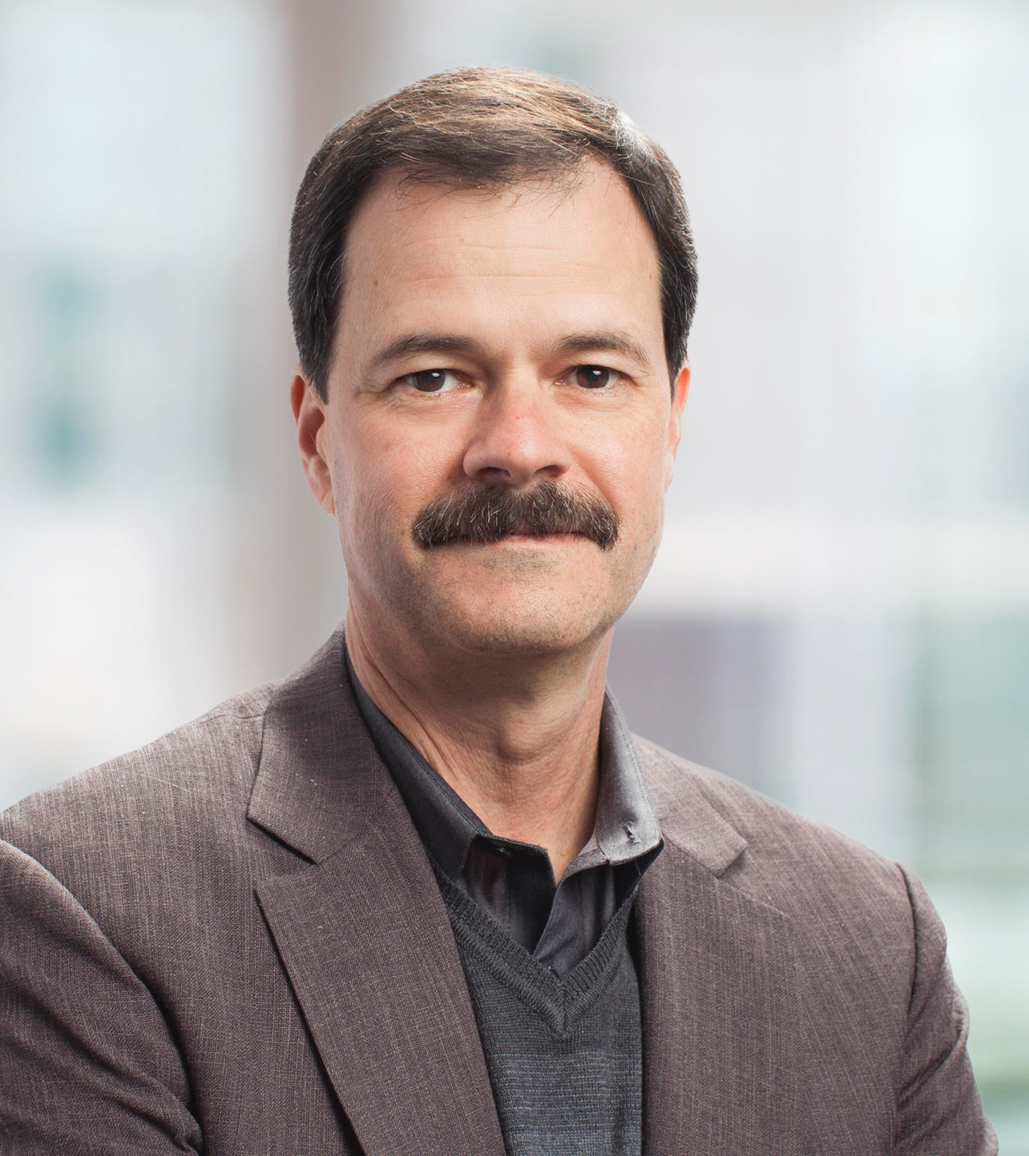
Miller Abel
Miller Abel is Deputy Director, Principal Technologist, Financial Services for the Poor with the Bill & Melinda Gates Foundation. At the Gates Foundation he initiated the Mojaloop open-source program in 2016 and serves on the Mojaloop Foundation Board of Directors and as Chair of the Technical Governing Board.

Slide 4
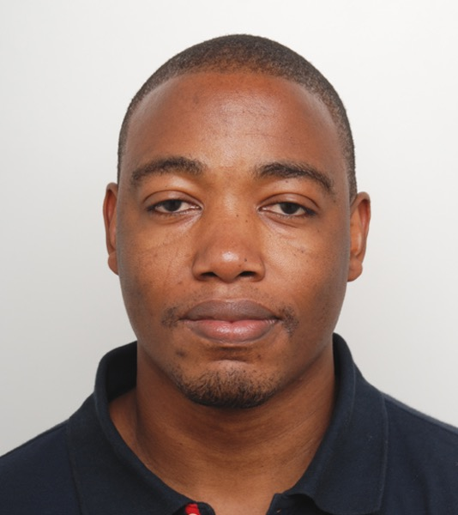
Benjamin Dotto
Benjamin Dotto is the Director of Infrastructure and Operations at the e-Government Authority under the President’s Office - Public Service Management. He is responsible for overall planning, design, development, implementation and delivery of e-Government infrastructure, technology, and services.
He is member of Management and Technical Committees for Tanzania Instant Payment System (TIPS), Government Electronic Payment Systems (GePG), he plays a vital role in its implementation and operation. Also, during his tenure in Private Sector (Business Connexion) he participated in the design and deployment for Umoja Switch

Slide 5
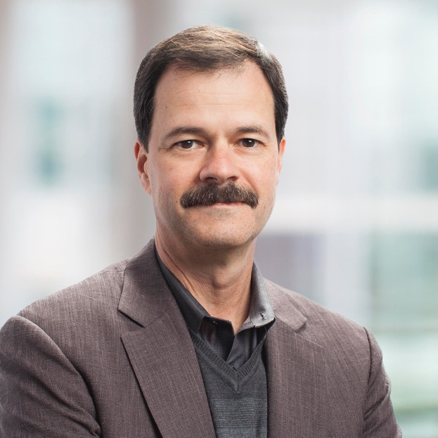
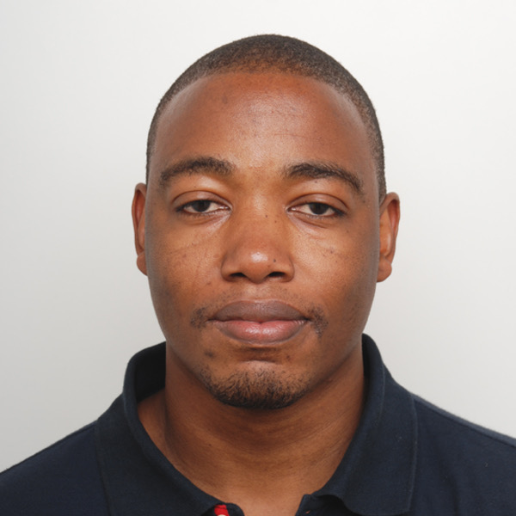
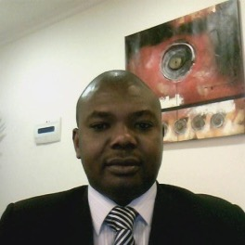
Importance of RTP in Tanzania
Panel discussion:
Miller Abel:
Bill & Melinda Gates Foundation
Benjamin Dotto:
e-Government Agency
Isack Nchunda:
Airtel Money Tanzania

